Slide 1
Local internal service & Module note
Research Ian 2024.08.29

Slide 2
Activate local internal service
Server be reboot and some service not set be activated after reboot
Check on every Monday morning

Slide 3
Procedure
New screen
Start service
Flat : http://192.168.3.152:7555/flat/
Noma : http://192.168.1.123:8023/map/
Jupyter notebook: http://192.168.1.123:8000/tree
module_note: http://192.168.3.152:8021/
flat: /home/covmo/miniconda3_new/envs/py310/bin/python /home/covmo/app/Flaton/manage.py runserver 0.0.0.0:7555
Noma: /home/covmo/miniconda3/envs/py37/bin/python /home/covmo/app/Noma/manage.py runserver 0.0.0.0:8023
Jupyter: /home/covmo/miniconda3/envs/py37/bin/python jupyter notebook –port 8000
Module_note:
cd /home/covmo/app/module_note
nohup npm run dev > /dev/null 2>&1 & OR sh /home/covmo/app/script/run_module_note.sh

Slide 4
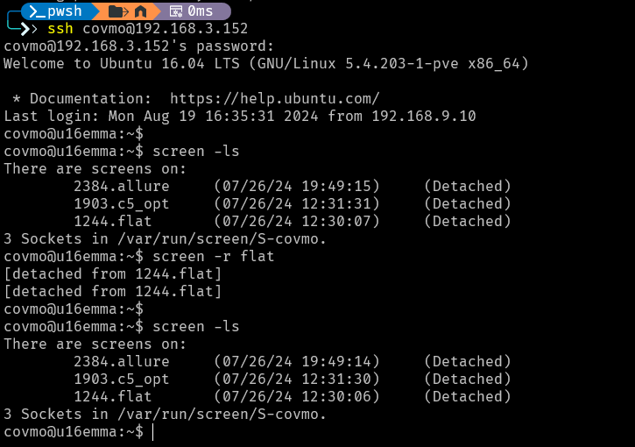
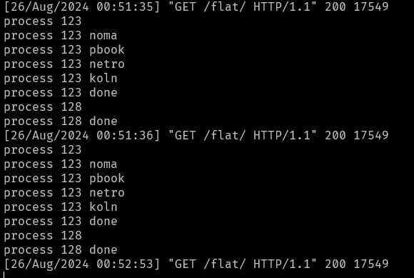
Screen
Create new screen
Create new screen: screen -S {name}
list screen shells: screen –ls
re-attach: screen -r {screenShell Id_or_Name}
Detach
Detach: screen –D
Detach: Ctrl + a + d
Terminate screen
Terminate screen: ctrl + D
Terminate screen: exit

Slide 5
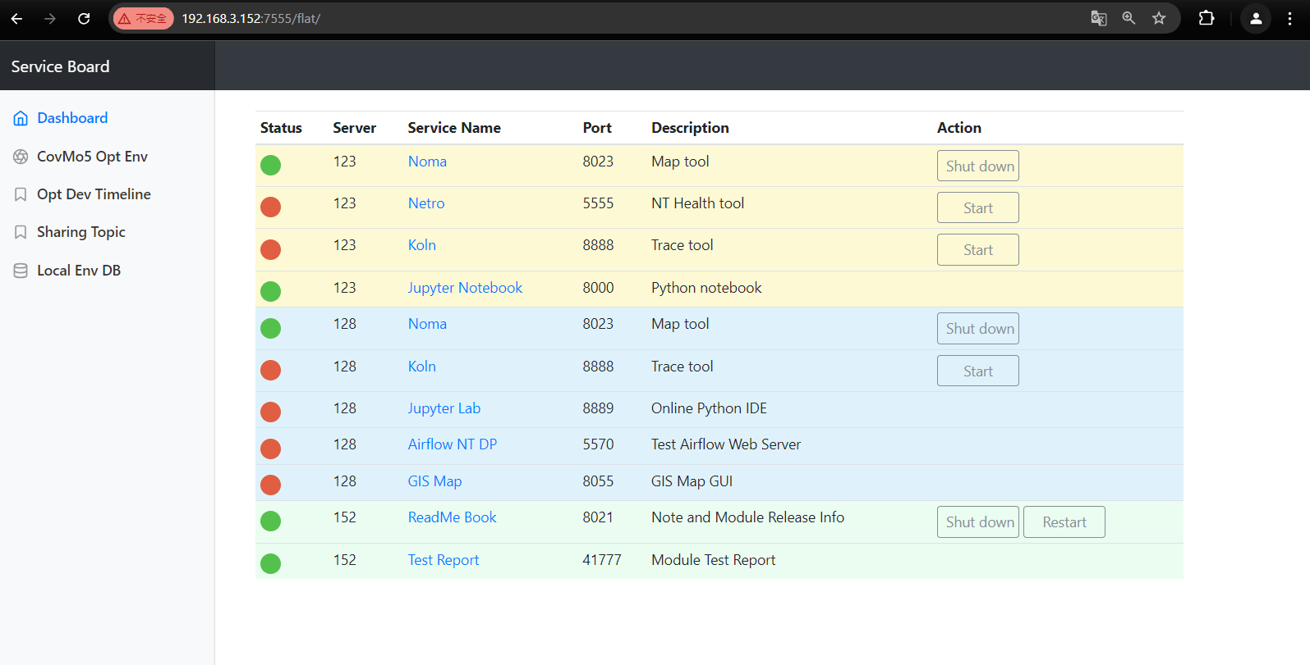
Flat

Slide 6
Modify the module note

Slide 7
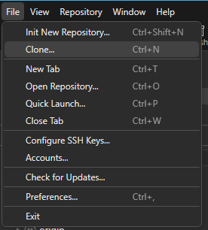
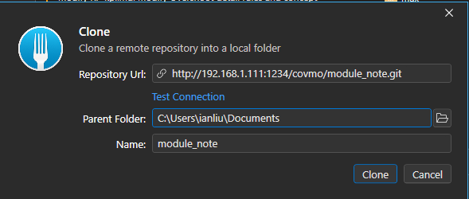
Clone module note
Module note
http://192.168.1.111:1234/
Login (Use Fork as a Git assistant tool)
User name: ianliu
Email : ianliu@ghtnic.com
Clone module note
File -> Clone
Repo Url(HTTP), folder, name
clone

Slide 8
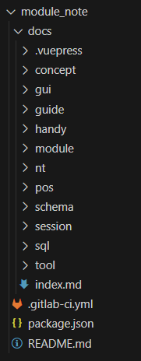
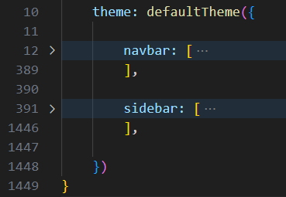
Add a new page & Modify existing page
Add a markdown file in the corresponding folder
Add the destination in both the navbar and sidebar sections
Path: module_note/docs/.vupress/config.js

Slide 9
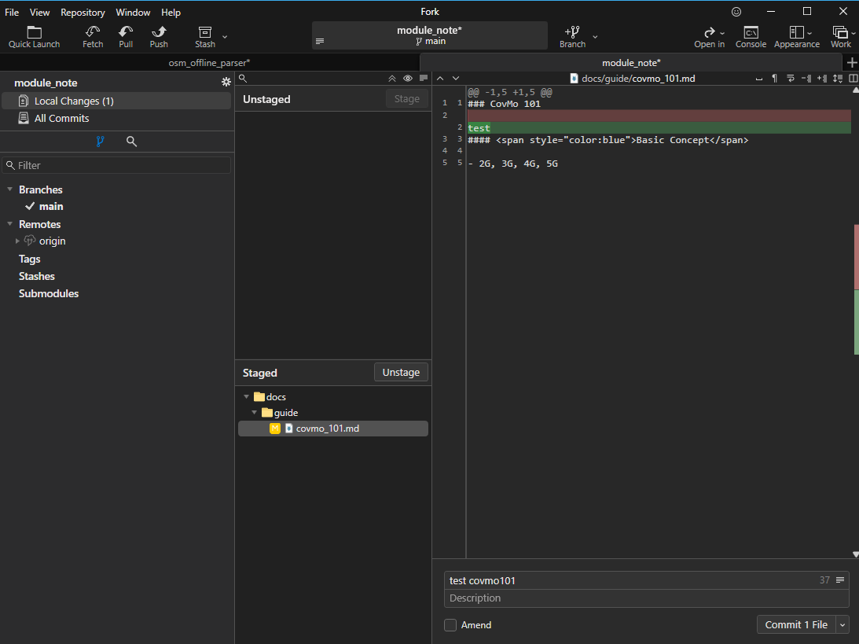
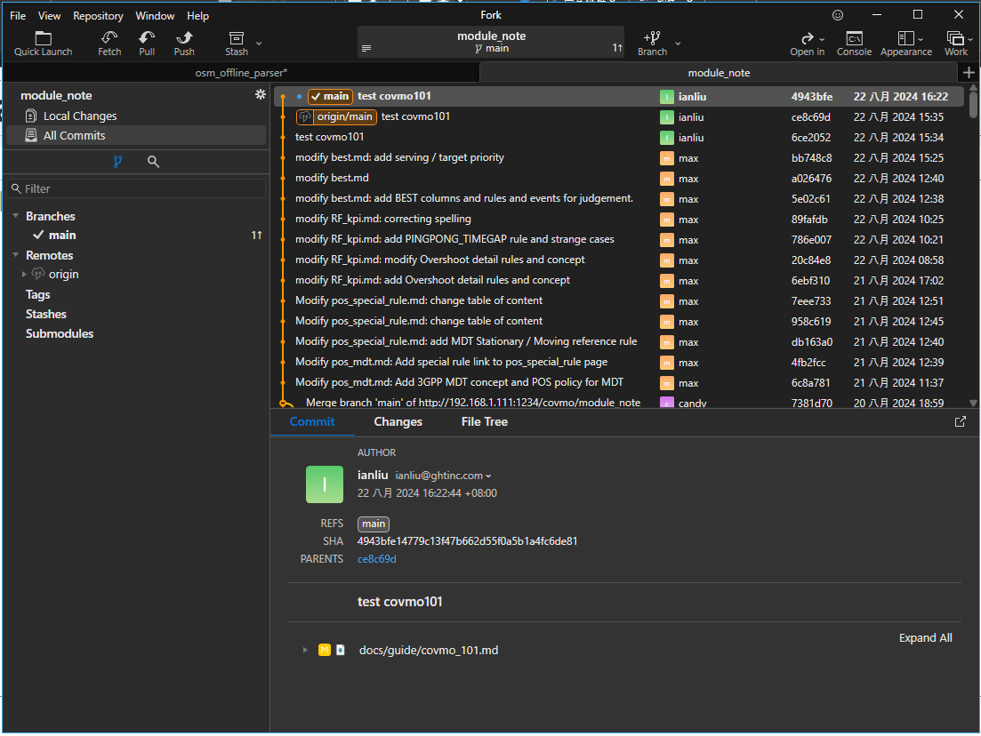
Push to GitLab
Fork: Stage -> commit -> push
Git command: git add . git commit –m “{commit message} git push
3
1
2

Slide 10
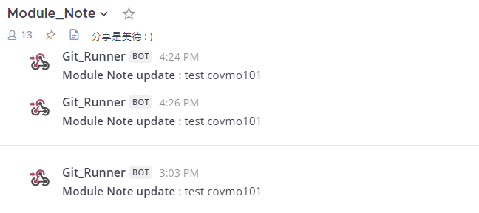
Double check
Mattermost – Module_Note

